Slide 1
Tutorial
Creating a Basic Search
on
connect.ebsco.com

Slide 2
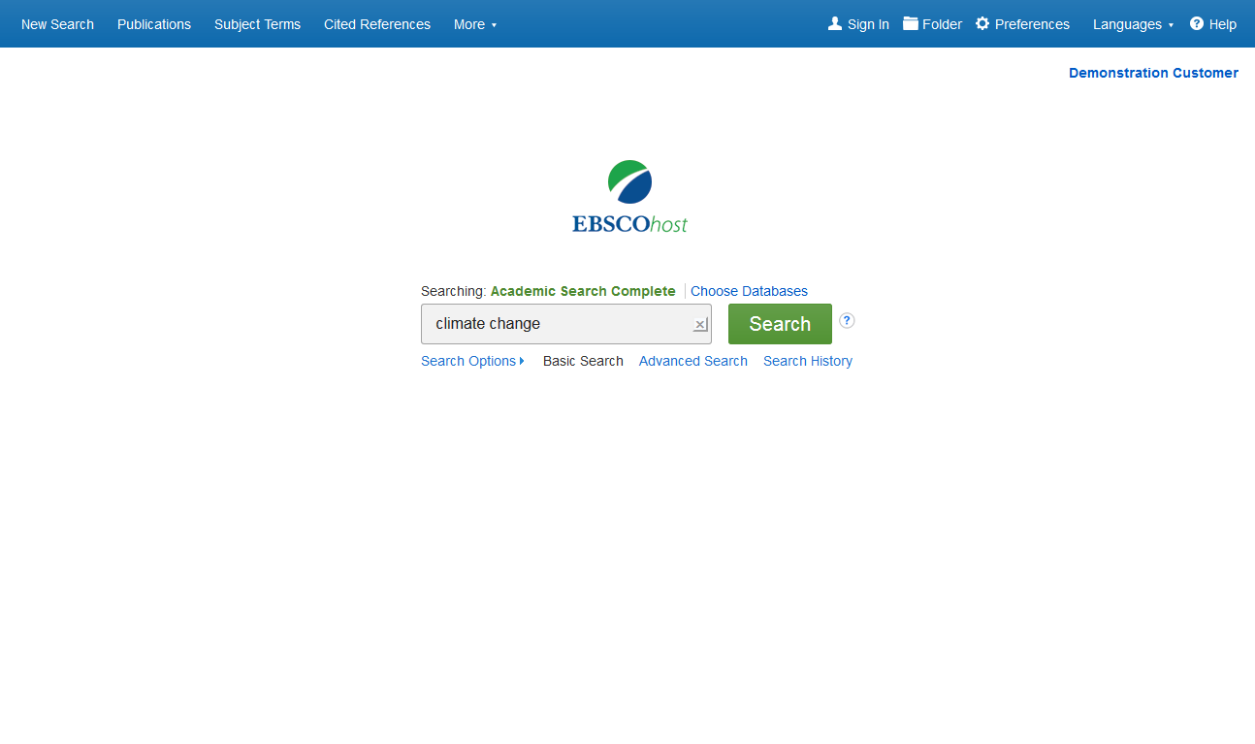
EBSCOhost is a powerful online reference tool that offers a variety of full text databases and popular databases from leading information providers. In this tutorial, we will look at conducting a search from the Basic Search screen of EBSCOhost.
Begin by entering your search terms in the search box. Click the Search button to view results or click Search Options to apply limiters and expanders.

Slide 3
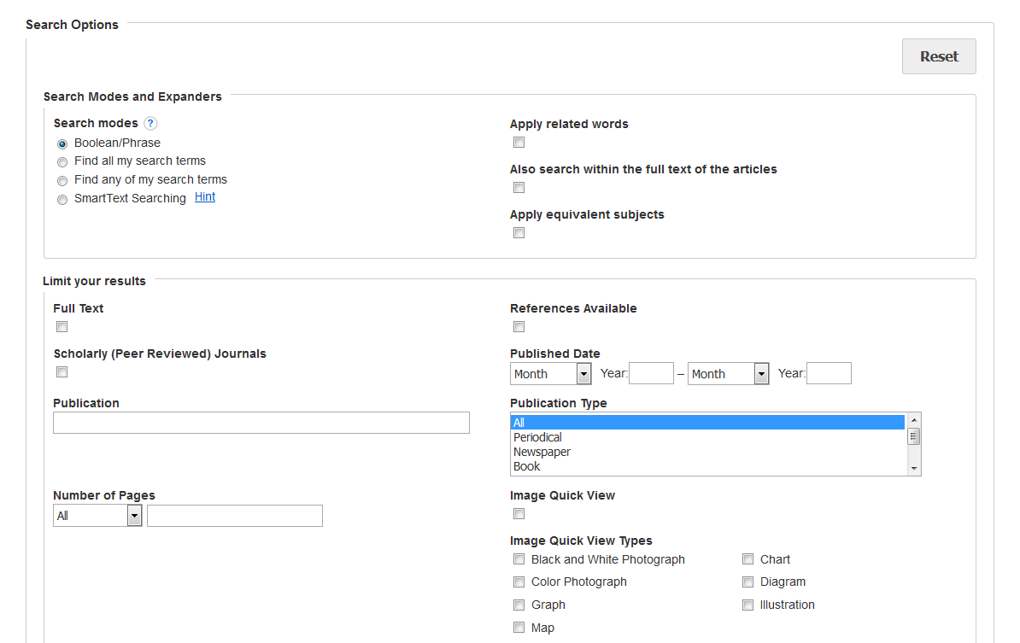
Search Options allow you to limit or expand your search results before viewing the result list. Choose one of the available Search Modes and depending upon the databases you are searching, you may see the ability to limit results by Full Text articles, Scholarly (Peer Reviewed) Journals, or a particular publication. After applying limiters and expanders, click Search.

Slide 4
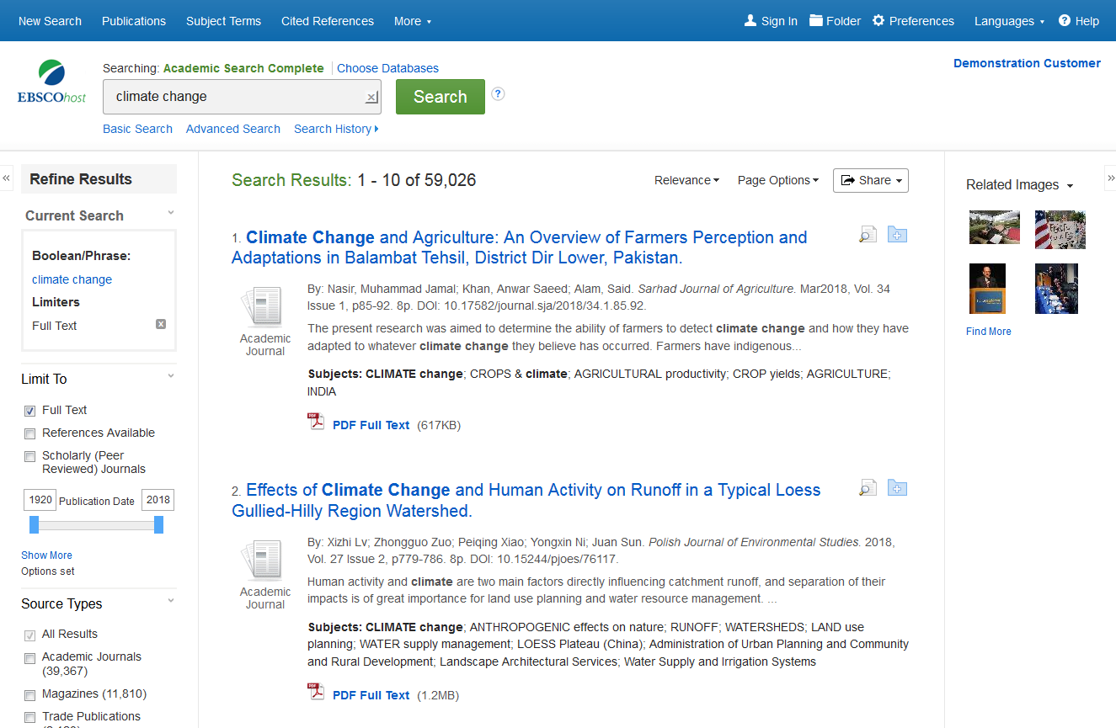
You can refine your results using the options in the Refine Results column. Results can be filtered by source types, such as Academic Journals, Magazines, or Newspapers, by clicking the checkboxes next to the desired source type.

Slide 5
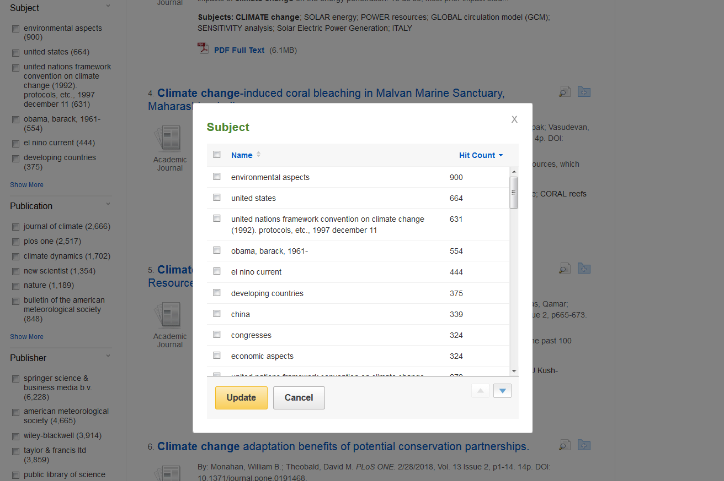
Depending on the database being searched, you can also use the facets in the left column to limit your search results to specific subjects, publications, or titles from a particular publisher, in addition to several other available options. You can click the Show More link to apply multiple selections at once.

Slide 6
Click an article title to view the Detailed Record, or click a full text link to read an article.

Slide 7
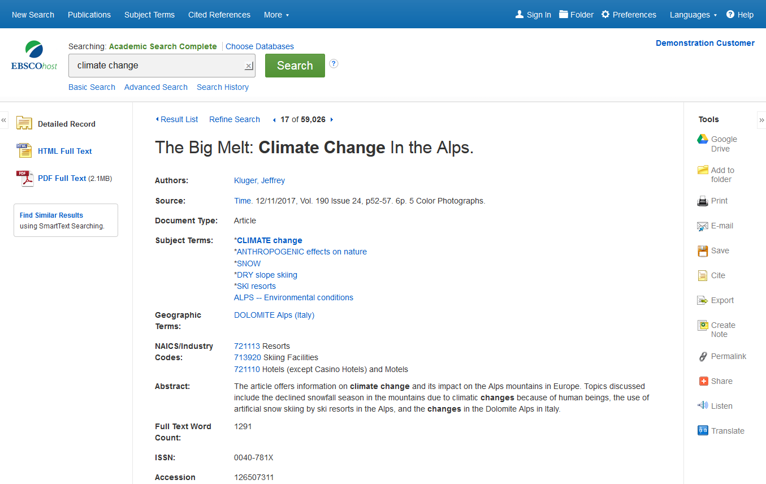
Print, email, save, cite or export a single result from the Detailed Record. To print, email, save, cite or export multiple results, add them to the folder, then click the appropriate icon inside the folder. Folder contents can be permanently saved by clicking on the Sign In link, and then creating a personalized My EBSCOhost folder account at no charge.

Slide 8
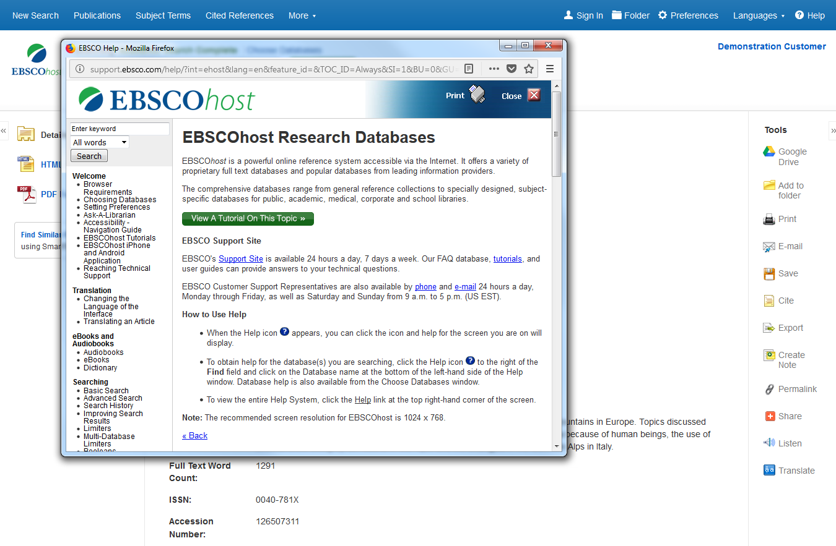
At any time, click the Help link to view the complete online Help system.

